Slide 1
Week8 WAL / Manifest
Made by Suhwan Shin, Isu Kim
E-Mail: tlstnghks77@naver.com

Slide 2
Content
WAL Testing with RocksDB
WAL disabled and abruptly shutting down
WAL enabled and abruptly shutting down
Manual WAL flushing and abruptly shutting down
Conclusion
Version Control

Slide 3
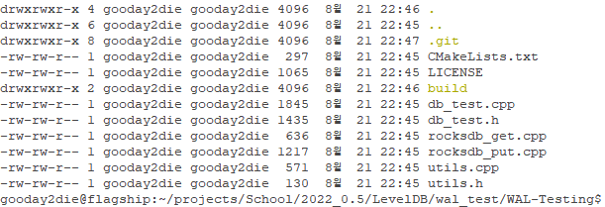
WAL Testing with RocksDB
Was interested in WAL’s real performance.
Tried making a --disable-wal option for LevelDB, but failed.
Thus, using RocksDB for WAL enabling and disabling.
Decided to make a simple C++ program that tests this topic.
Code can be found in the link below
https://github.com/gooday2die/WAL-Testing

Slide 4
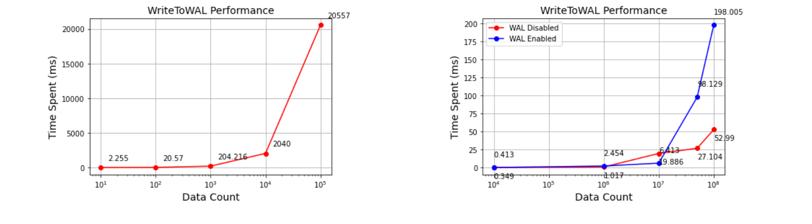
WAL Testing with RocksDB – Hypothesis
WAL Enabled put will be guaranteed and stored properly.
WAL Disabled put will have potential loss of data (or all).
With prior knowledge:

Slide 5
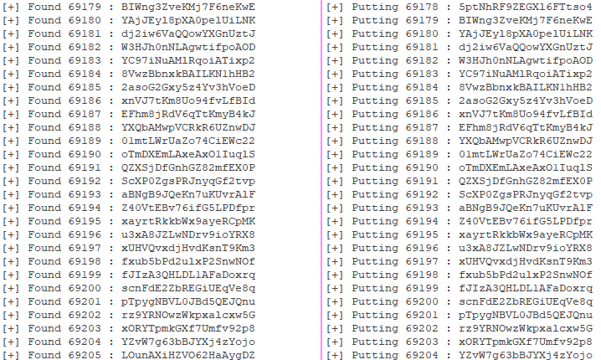
WAL Testing with RocksDB – Design (Put)
putRocksdb
Put key - value pair into RocksDB.
Has option of enabling or disabling WAL.
Key represents iteration count.
Values are made up of randomly generated string length of 20.
Will put key – value pair 1,000,000 times.
manualFlushPutRocksdb
Same as putRocksdb but will manually flush in every
1000 iterations.

Slide 6
WAL Testing with RocksDB – Design (Get)
getRocksdb
Opens generated RocksDB from putRocksdb.
Get keys starting from 0 to a key that has empty value.

Slide 7


WAL Testing with RocksDB – Design
Execute putRocksdb
Kill putRocksdb using CTRL + C in Linux.
Get stored values from RocksDB using getRocksdb.
Does have offset of 1 or 2 entries since CTRL + C has delay of killing process.

Slide 8
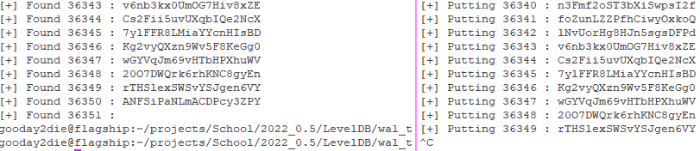
WAL Testing with RocksDB – Results : WAL Enabled
WAL Enabled
Could get all data that were put before into RocksDB
WAL definitely guarantees put action into RocksDB and does not lose any data even if shutdown abruptly.

Slide 9
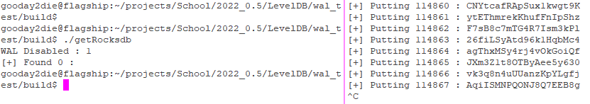
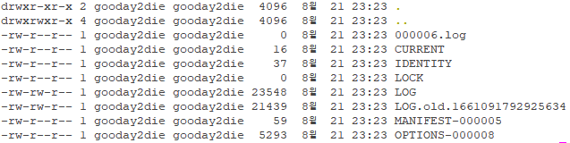
WAL Testing with RocksDB – Results : WAL Disabled
WAL Disabled
Could not get any data that were put before into RocksDB
Something is strange!
Lost all data

Slide 10

WAL Testing with RocksDB – Results : Manual WAL Flush
WAL Enabled & Manual Flush
Could get all data that were put before into RocksDB
Enabling WAL and manual flush is in fact meaningless.
Since enabling WAL will automatically generate state that can already recover data from being lost.

Slide 11
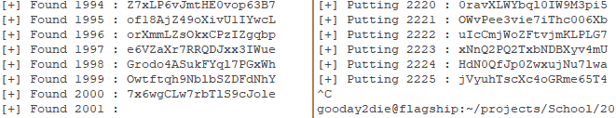

WAL Testing with RocksDB – Results : Manual WAL Flush
WAL Disabled & Manual Flush
Could get partial data that were put before into RocksDB
In every 1000 iterations, we manually flush WAL.
Thus will flush at 2000th key.
This will store data till 2000th key, but will lose from 2001th key.

Slide 12
WAL Testing with RocksDB – Conclusion
Summarization
WAL Type | Speed | Data Integrity | Scenario
WAL Disabled | 1.843s | Losing All | Speed demanding, but data is not critical.
WAL Enabled | 3.604s | Saving All | Data is very critical.
Manual Flush & WAL Enabled [0] | 40.502s | Saving All | Meaningless.
Manual Flush & WAL Disabled [0] | 39.128s | Partial Loss | In compromisable situations, but tuning is required.
Manual Flush & WAL Enabled [1] | 7.773s | Saving All | Meaningless.
Manual Flush & WAL Disabled [1] | 5.611s | Partial Loss | In compromisable situations, but tuning is required.
Did not print out putting values for removing IO delays.
Execution time measured by time from Linux.
Put values of 1,000,000 entries.
[0] Manual flush in every 1,000 entries.
[1] Manual flush in every 10,000 entries.

Slide 13
VersionSet
The entire set of versions is maintained in a VersionSet
Current : The newest version (Older version may be kept or not)
Status
LogAndApply() // Apply *edit to the current version to form a new descriptor
Recover() // Recover the last saved descriptor from persistant storage
Function
LogNumber() // Return current log file number
PrevLogNumber() // Return log file number currently being compacted OR 0
…

Slide 14
VersionEdit
Function
SetComparatorName()
SetLogNumber()
SetPrevLogNumber()
SetNextFile()
SetLastSequence()
Addfile() // MetaData
Removefile() // MetaData
…

Slide 15
NewDB
NewDB
VersionEdit::SetComparatorName → Comparator
VersionEdit::SetLogNumber → log_number (0)
VersionEdit::SetNextFile → next_file_number (2)
VersionEdit::SetLastSequence → last_sequence (0)
Make manifest file
- NewWritableFile(manifest, &file)
Create Log(file)
- AddRecord() → EmitPyhsicalRecord()
// Checks Record Type and writes data using EmitPhysicalRecord.

Slide 16
Recover
DBImpl::Recover (VersionEdit* edit, bool* save_manifest) // Recover the descriptor
VersionSet::Recover (bool* save_manifest) // Recover the last saved descriptor
NewDB
No
FileExists
(CurrentFileName_)
Yes
VersionSet::Recover
RecoverLogFile
Recover from all newer log files than the ones named in the descriptor

Slide 17
Recover
RecoverLogFile()
Open the log file
Create the log reader log::Reader
Read all the records and add to a memtable
DBImpl::Recover → VersionSet::Recover / DBImpl::NewDB
DBImpl::Recover → VersionSet::AddLiveFiles // Add all files listed in any live version
DBImpl::Recover → VersionSet::MarkFileNumberUsed // Manually update the file number
DBImpl::Recover → VersionSet::SetLastSequence
return Status::OK

Slide 18
CompactMemTable
Compact the in-memory write buffer to disk.
Switches to a new log-file/memtable and writes a new descriptor iff successful.
1. Save the contents of the memtable as a new Table
- WriteLevel0Table() : Manage MetaData
2. Replace immutable memtable with the generated Table
- SetPrevLogNumber(0)
- SetLogNumber(logfile_num) : Ealier log no longer needed
- LogAndApply()

Slide 19
DB::Open
1. DBImpl::Recover (VersionEdit* edit, bool* save_manifest (=false))
Create new log and a corresponding memtable
if
Impl_mem
null
NewFileNumber()
NewWritableFile()
if
SetPrevNumber()
SetLogNumber()
Save_manifest
false
LogAndApply()
else
RemoveObsoleteFiles
MaybeScheduleCompaction()

Slide 20

Question

